Slide 1
REDESIGN UDEMY APP – UX CASE STUDY
P K LINGESH KUMAAR(211701026)
D MANO DHASHIN(211701030)
Mentor: Mr. Gunasekar S
BATCH NO. : B2121M16

Slide 2
PROJECT OVERVIEW
UDEMY The objective of this project is to redesign the Udemy platform to prioritize and enhance community interaction among learners, instructors, and subject matter experts. By revamping existing features and introducing innovative community engagement functionalities, the goal is to create a dynamic learning ecosystem where users can collaborate, network, and learn from each other effectively.

Slide 3
PROBLEM STATEMENT
The current UDEMY platform lacks robust community engagement features, interactive discussion forums, and effective collaboration tools, hindering meaningful knowledge sharing and peer learning among users. There is a pressing need to address these deficiencies to create a more engaging and collaborative learning environment for students, professionals, and learners from diverse fields.

Slide 4
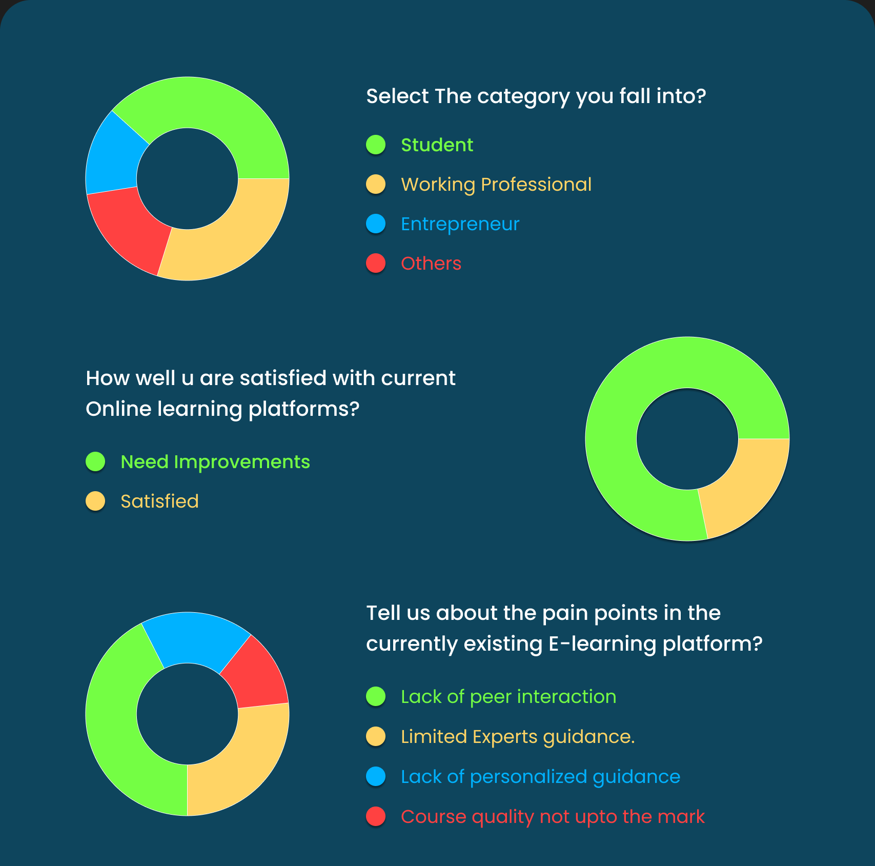
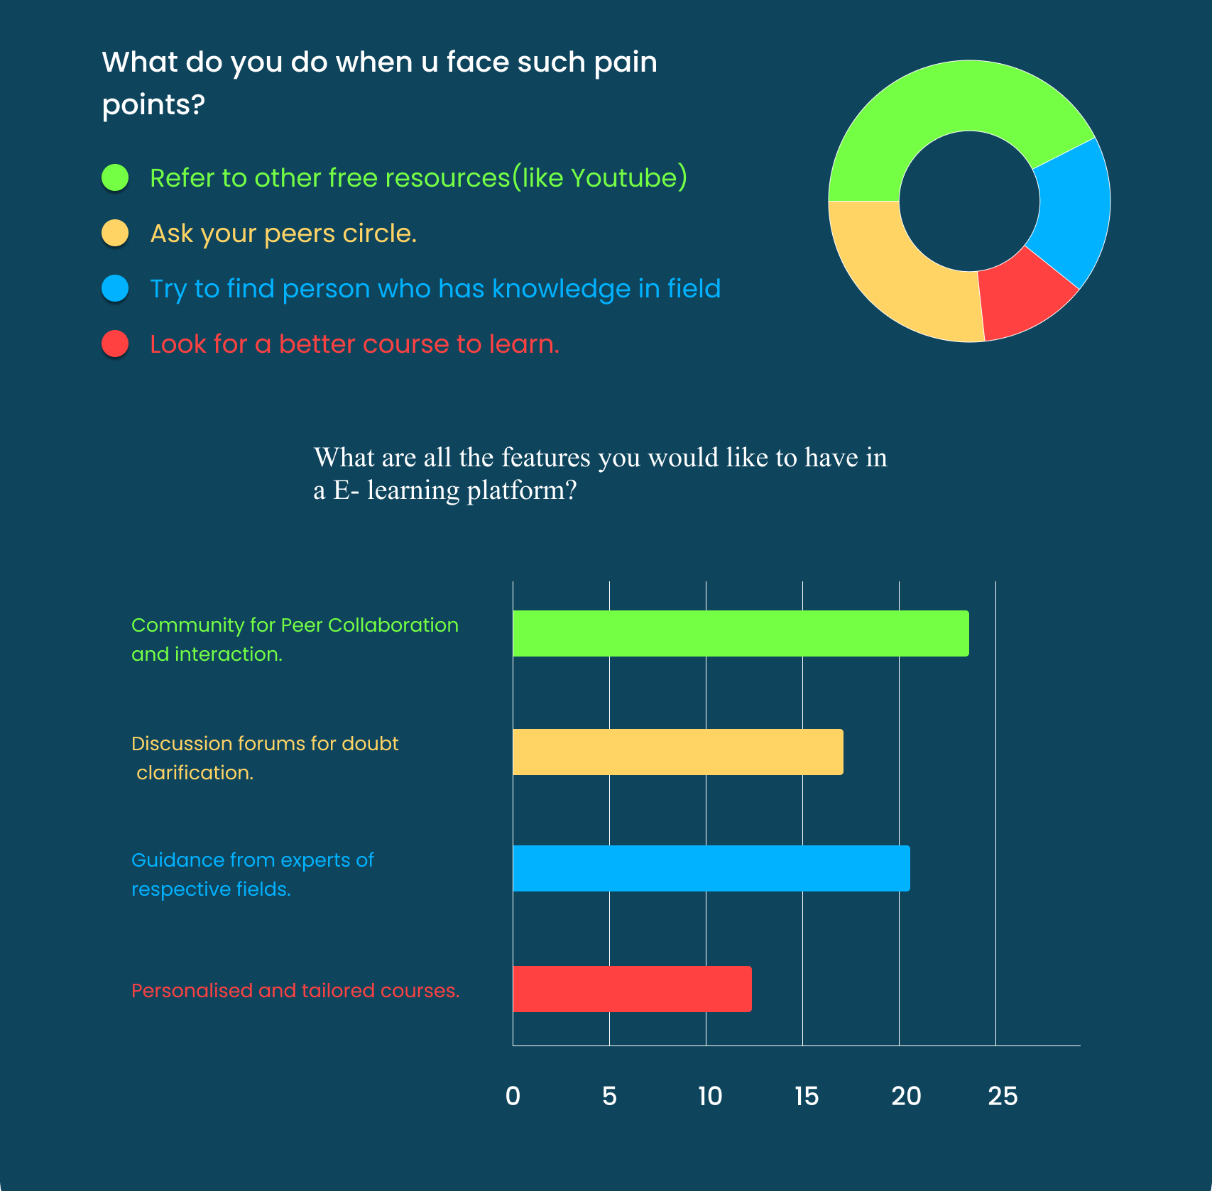
USER RESEARCH USER SURVEY

Slide 5
SURVEY RESPONSE
Based on a live survey with diverse users, key desires for Udemy's enhancement emerged:
1. Community Features: Users stressed robust community tools like forums and networking for better engagement.
2. Interactive Discussion: They sought interactive forums with real-time chat and multimedia integration.
3. Collaboration Tools: Desire for group projects and peer review to foster teamwork and skill development.
4. Peer Learning: Users value peer mentoring and feedback for diverse perspectives and deeper insights.
Implementing these insights can create a more engaging and supportive learning platform.

Slide 6

PERSONA 1

Slide 7

PERSONA 2

Slide 8
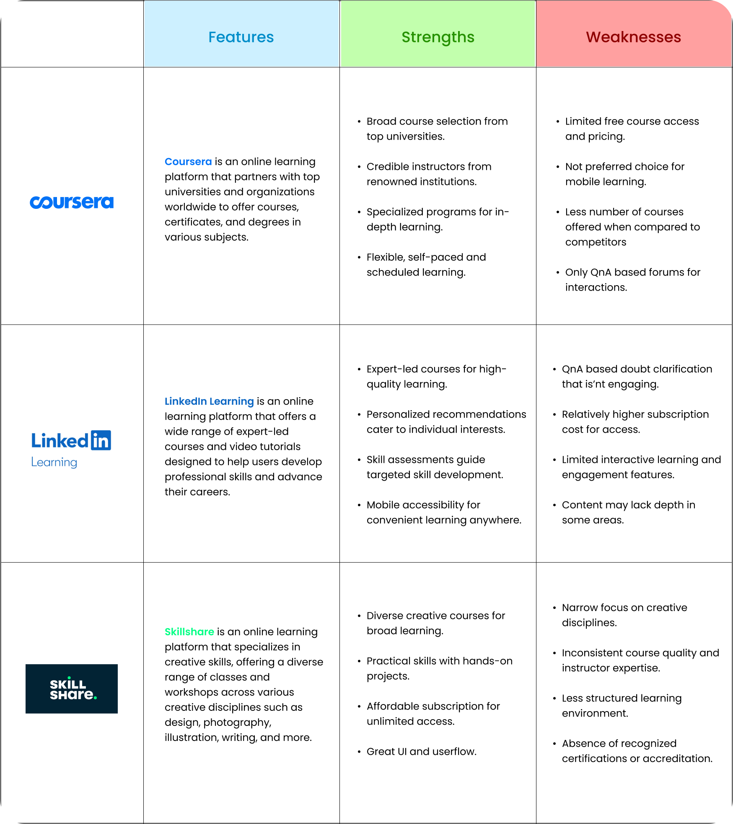
COMPETITIVE ANALYSIS

Slide 9
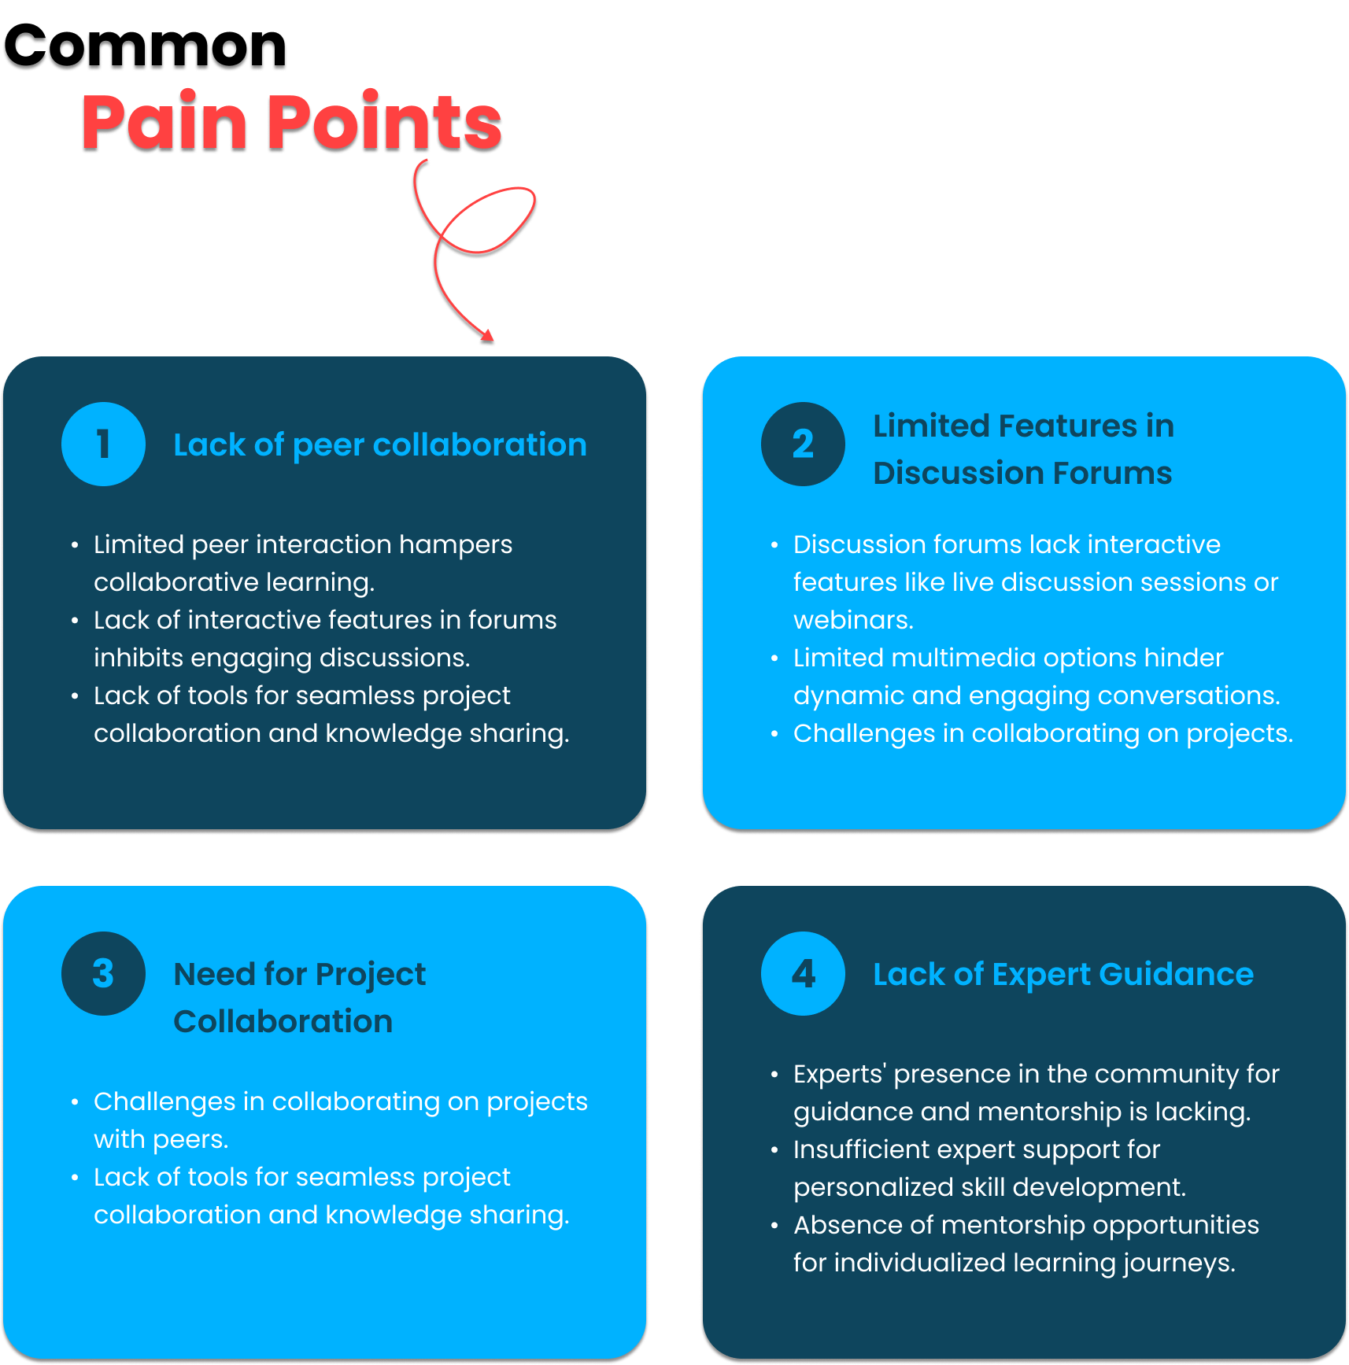

Slide 10
PROPOSED SOLUTION
"Udemy offers a unique solution by providing a vibrant peer community, robust discussion forums and collaborative learning experiences , setting it apart from competitors in the e-learning space." 1. Peer Community: Udemy fosters a vibrant peer community where learners can connect, collaborate, and support each other in their learning journey. 2. Discussion Forums: Our platform provides feature-rich discussion forums where learners, peers, and tutors can engage in meaningful discussions, share insights, and seek guidance on various topics and courses. 3. Collaboration: Udemy encourages collaboration among users by facilitating group projects, study groups, and collaborative learning experiences to enhance understanding and knowledge sharing

Slide 11
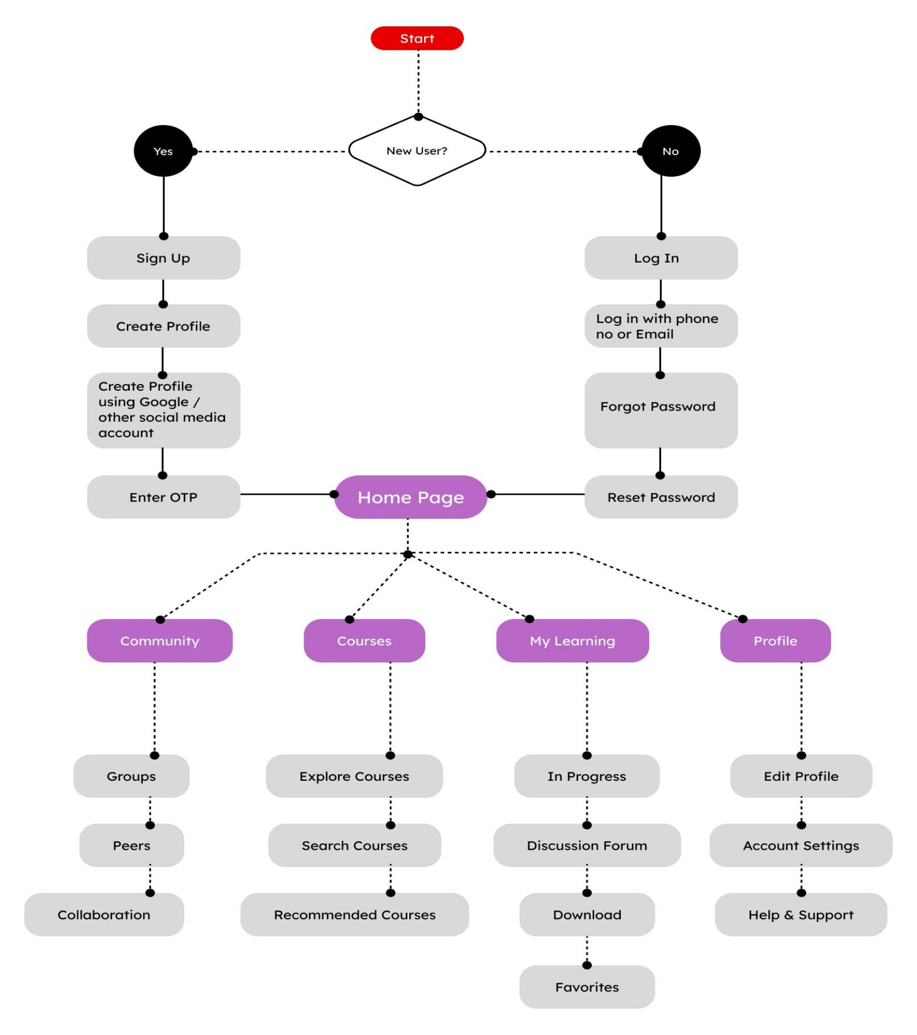
USER FLOW

Slide 12
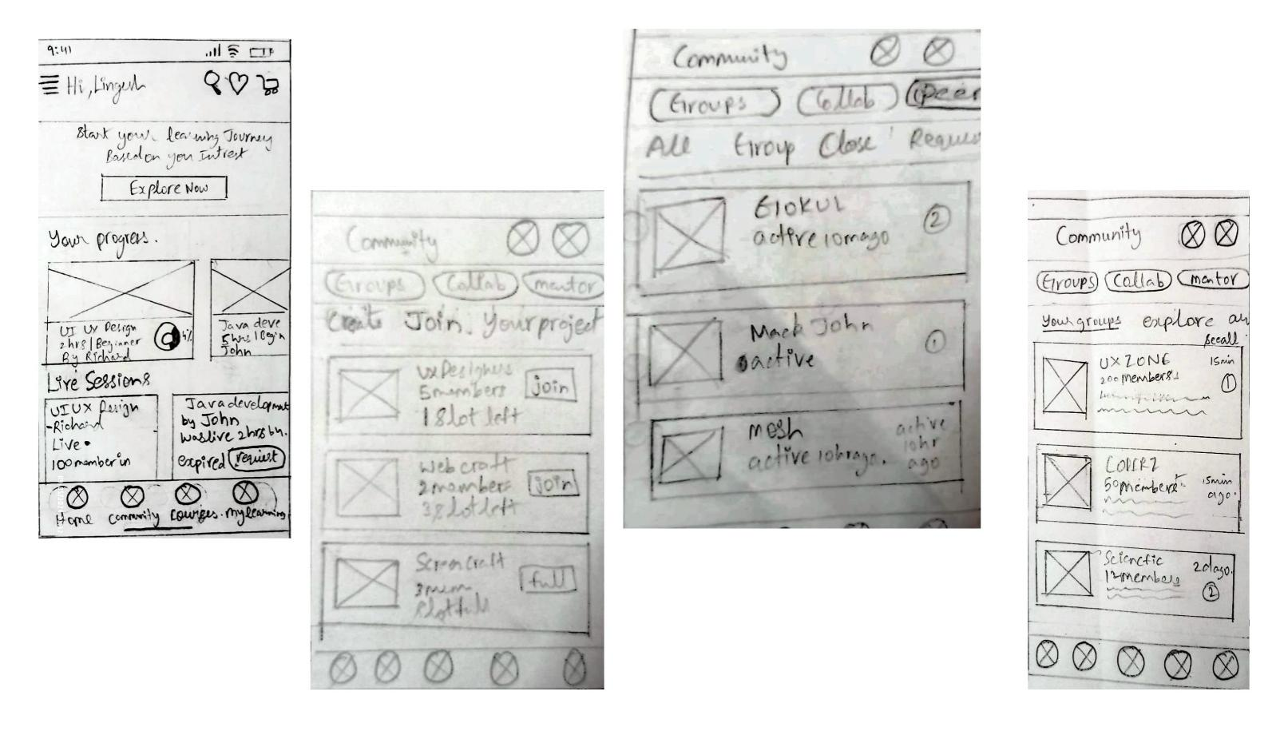
WIREFRAMES
Wireframes are skeletal outlines or blueprints of a digital product, such as a website, mobile app, or software interface, created during the early stages of UX design.

Slide 13
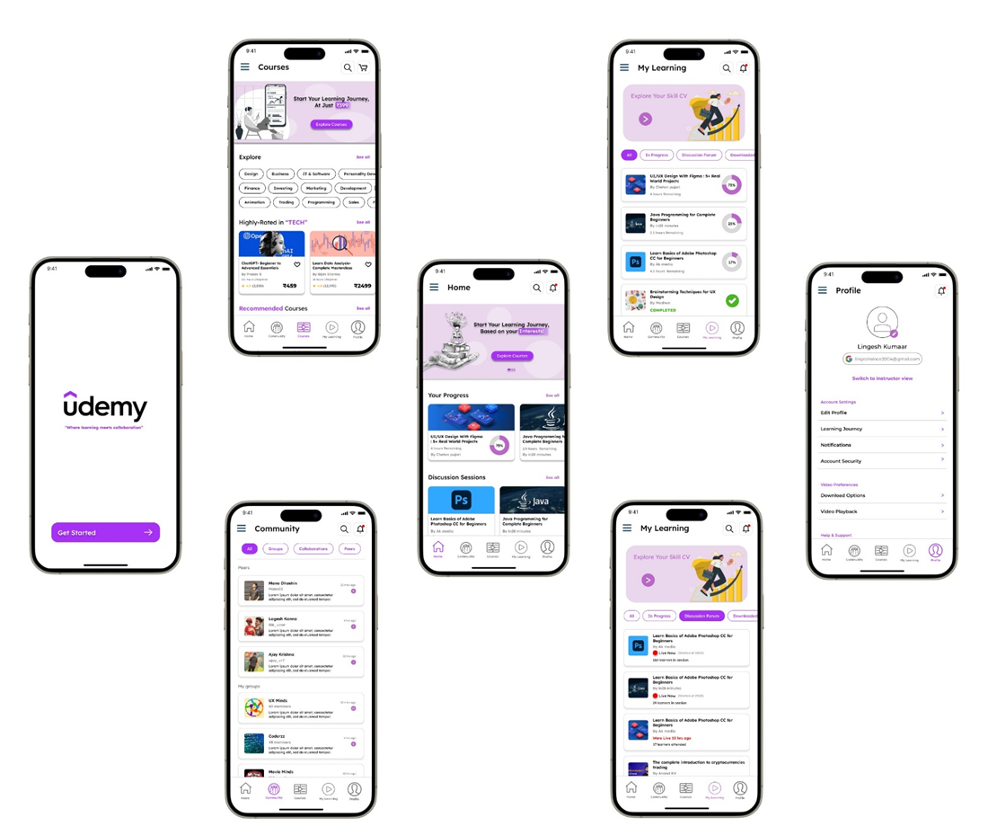
FINAL PROTOTYPE

Slide 14
CONCLUSION
Case study underscores the imperative for enhancing community engagement, interactive discussion forums, and collaboration tools on the Udemy platform. By addressing these deficiencies, Udemy can foster a more engaging and collaborative learning environment, empowering users to maximize their learning potential. Implementing user-centric design improvements will not only enhance user satisfaction but also position Udemy as a leading platform for lifelong learning and skill development. Through continuous iteration and innovation, Udemy can further solidify its reputation as a premier destination for online education, catering to the diverse needs of learners worldwide.

